Slide 1
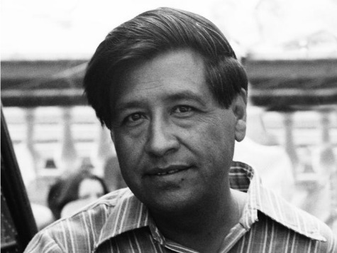
Cesar Chavez

Slide 2
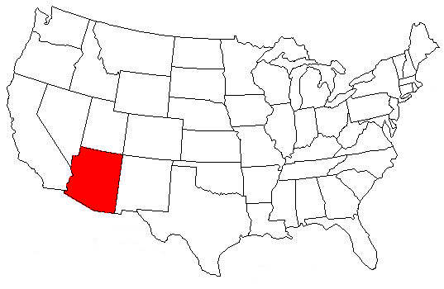
Early Years
Born in Yuma, Arizona in 1927.
His parents were from Mexico.
Cesar’s father was a farmer and owned a grocery store and garage.
Cesar’s father taught him how to work diligently.
Cesar’s mother taught him the importance of thinking about others.
Talking, not fighting is the way to solve problems.

Slide 3
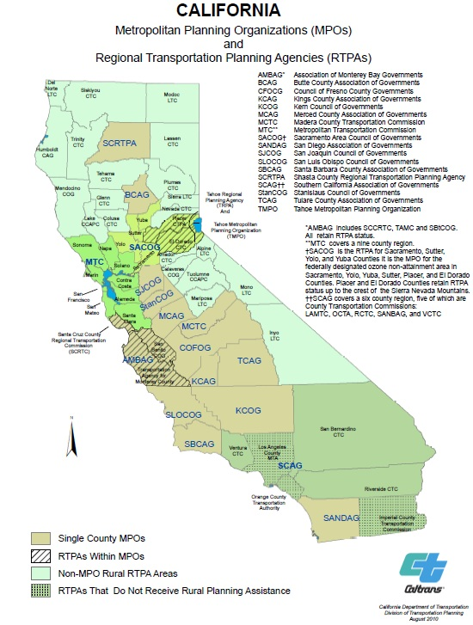
Early Years Cont.
1930: The Chavez family lost their farm and grocery store.
1937: Chavez family moved to the Imperial Valley in southern California.
Imperial Valley is an important farming region.
The Chavez family became migrant workers.
A person who goes from place to place searching for work.

Slide 4
Migrant Workers
Migrant workers live in camps provided by farm owners.
Living conditions were bad.
No running water or electricity.
Cesar’s father was very mad at how the migrant workers were treated.
He told his family to stop working.
Cesar realized that it was important to stand up for workers’ rights.

Slide 5
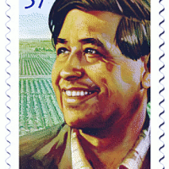
Early Years Cont.
Cesar went to more than 30 schools because his family moved around so much.
He would have to miss school so he could work.
At school the teachers and other students would not treat him and other migrant worker students with respect.
8th grade was his last year in school.
He went to work full time to help earn money for his family.

Slide 6
Justice for All
Chavez was very unhappy with working conditions.
He wanted the following for the workers:
Payment for their work.
Workers should be allowed to speak their native language.
People should be treated equally.
17: He joined the Navy.
Mexican Americans were also treated unfairly in the Navy.

Slide 7
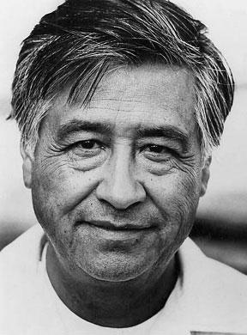
Justice for All
After the Navy he moved to San Jose, California.
Chavez went back to working on the farm.
They lived in a one room shack surrounded by map. They did not have running water or electricity.

Slide 8
CSO: Community Service Organization
1952: Chavez got a job with the CSO.
A group that worked for justice for all people.
Chavez had to speak to groups of people about working together to change things.
Chavez was a good leader and community organizer.
An organizer is someone who brings people together.

Slide 9
Rights for Farm Workers
Chavez studied about Martin Luther King Jr. and Mohandas Gandhi.
Chavez became the leader of the CSO in 1959.
He helped thousands of people from Mexico become citizens.
He helped people sign up to vote.
He taught people about their rights.
Chavez wanted to start a labor union.
A labor union is a organization of people who help to better work conditions and pay.
1962: Left the CSO to form the Farm Workers Association.

Slide 10
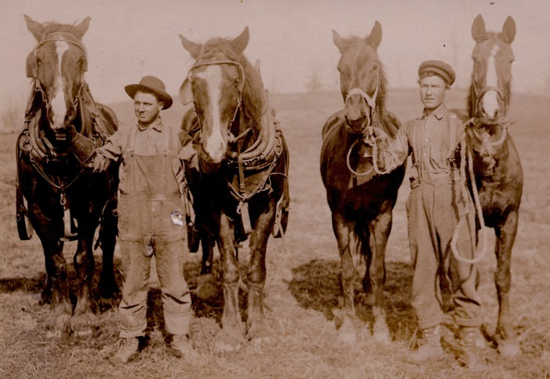
Rights for Farm Workers
FWA was a labor union.
The union spoke up for the workers.
Chavez wanted to better working conditions.

Slide 11
Success
1965: A small union of grape pickers went on strike.
A strike is the refusal by workers to work to protest low pay or poor working conditions.
Chavez supported the union.
1966: The two unions joined together.
Chavez used non-violent protests to express workers’ rights.

Slide 12
Success
The UFW also used a march.
An organized walk taken by a group of people to make a point.
Chavez and 70 others walked from Delano to Sacramento.
This was a 340 mile walk.
20,000 people joined the march.
Chavez led many more marches.
During the 80’s Chavez and many others went on a fast.
A fast is when you refuse to eat.
This lasted for 36 days.

